Slide 1
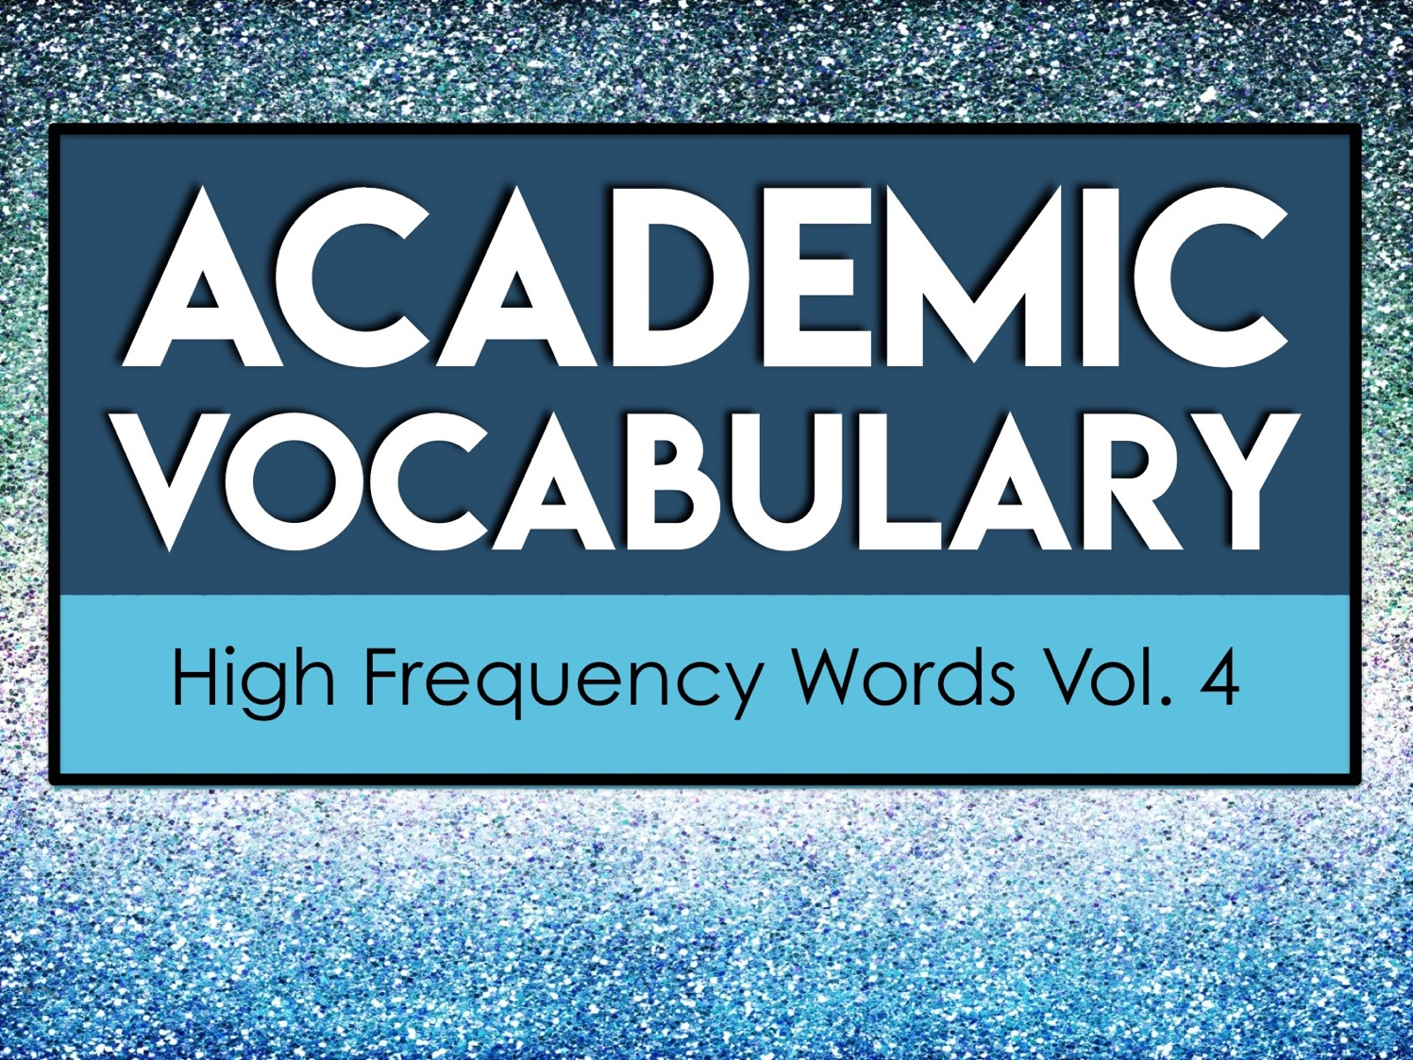
Academic
Vocabulary
High Frequency Words Vol. 4

Slide 2
About Academic Vocabulary
Academic vocabulary refers to words that you will likely encounter in an academic setting.
Academic vocabulary shows up in text books, standardized tests, and in instructions for school assignments.
The more academic vocabulary you know, the more likely you are to be successful in school!

Slide 3
About Academic Vocabulary
The Academic Vocabulary words you’ll encounter in this unit are high-frequency vocabulary words that appear frequently in academic texts.

Slide 4
Focus on Five at a Time
We will learn 25 new academic vocabulary terms during this unit.
However, we will only focus on five words at a time.
Each week we will have five new words to learn.

Slide 5
Our Week in Academic Vocabulary
Monday: Introduce the words.
Tuesday: Draw it out.
Wednesday: Word Web Wednesday!
Thursday: Reflect about the words.
Friday: Quiz time!
End of the unit: We will review ALL 25 of the academic words you’ve learned.

Slide 6
Monday
On Mondays, we will take a quick pretest on five new vocabulary words.
Then, we will go over each word.
You’ll write the words and their definitions on your weekly handout.

Slide 7
Tuesday
On Tuesdays, we will take a few minutes to review the words.
During this time, you’ll draw a quick visual representation for each word.
The drawings do not need to be perfect. Anything that helps you associate the word to the definition will help you!

Slide 8
Wednesday
On Wednesdays, we will take a few minutes to review the words.
During this time, you’ll create a word web for each word.
A word web is a graphic representation containing words. You’ll write words that have similar meanings and words that are associated with the vocabulary term on your paper.

Slide 9
Word Web Example
language
list
vocabulary
terms
words

Slide 10
Thursday
On Thursdays, we will take a few minutes to review the words.
During this time, you’ll look over all of the work from the week and write a brief reflection about what you learned.
Your reflection should be at least three sentences long and contain some of the vocabulary words.

Slide 11
Reflect/Journal
Your vocabulary journal/reflection should be at least three sentences long. You can use these questions to help get you started.
What did you learn about the words?
What word did you not know prior to this week?
How do these words relate to one another?
How will knowing these words help you succeed in an academic setting?

Slide 12
Friday
On Fridays, we will take a quick test on five vocabulary words from the week.
After the test, you’ll record your score and write down the words you still need to study.
As we continue with new words, make sure you go back and revisit the words you still need to learn.

Slide 13
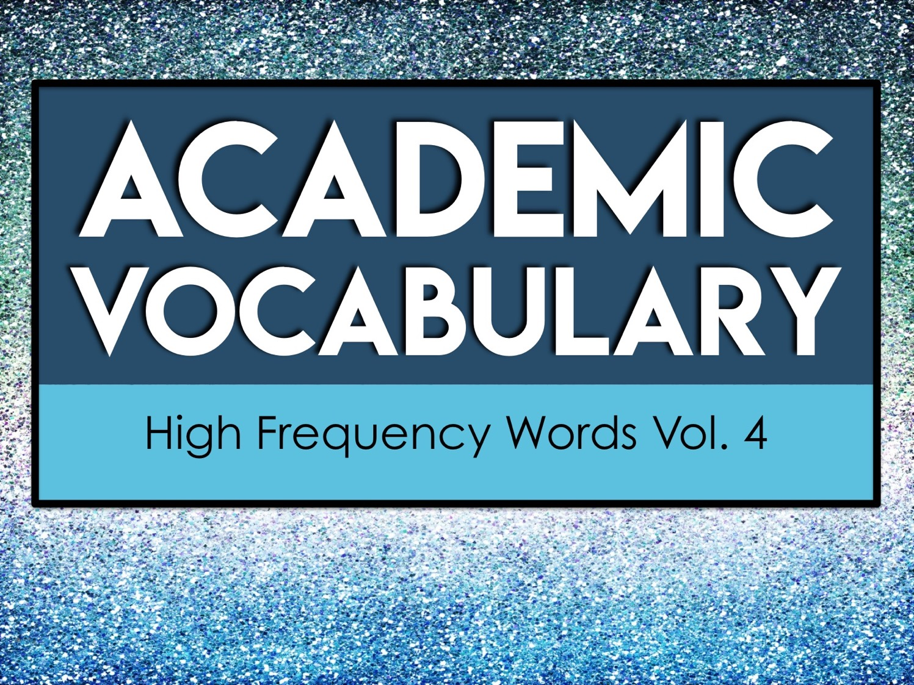
Academic
Vocabulary
High Frequency Words Vol. 4

Slide 14
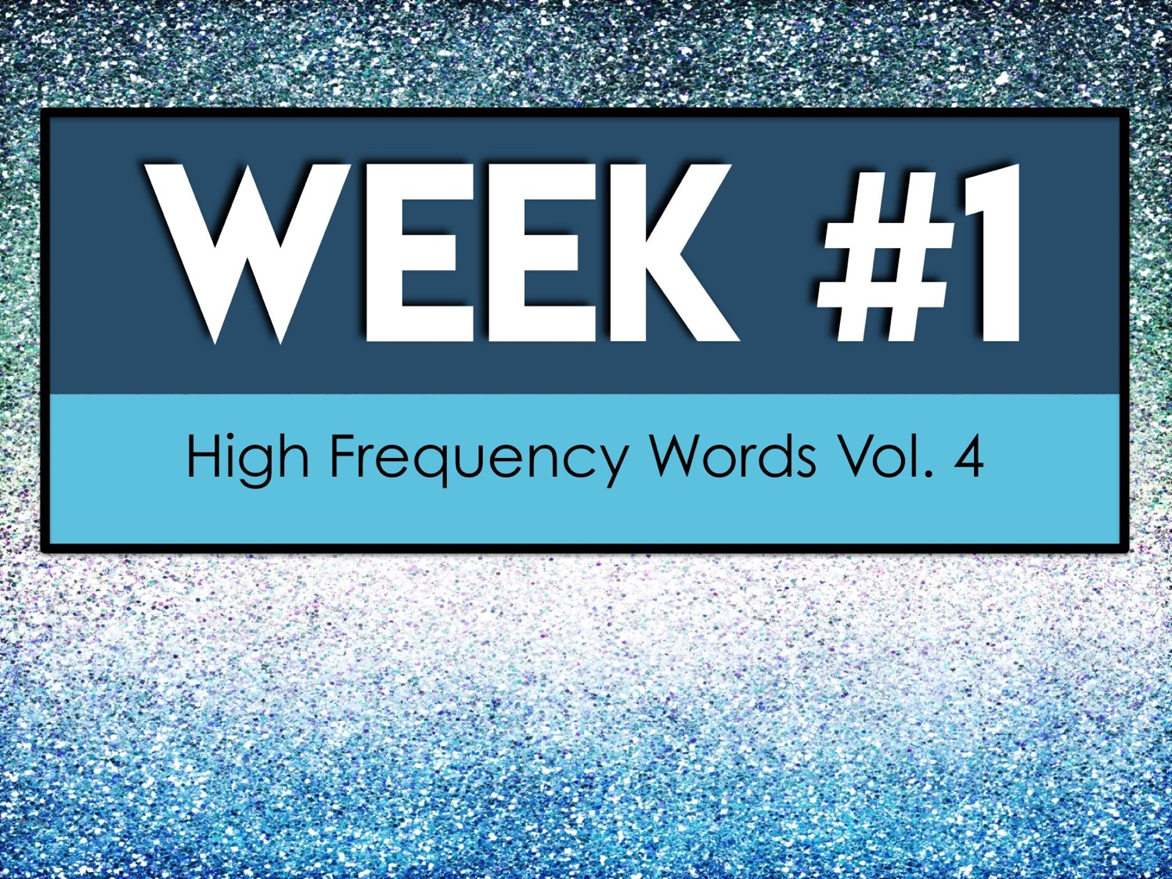
Week #1
High Frequency Words Vol. 4

Slide 15
Week #1 Words
Predominant
Presume
Previous
Primary
Process

Slide 16
Week #1 Pretest
DIRECTIONS: In your own words, try your best to define each term.
Predominant
Presume
Previous
Primary
Process

Slide 17
Predominant
present as the strongest or main elements

Slide 18
Presume
suppose that something is the case on the basis of probability

Slide 19
Previous
existing or occurring before in time or order

Slide 20
Primary
of chief importance; principal

Slide 21
Process
a systematic series of actions directed to some end

Slide 22
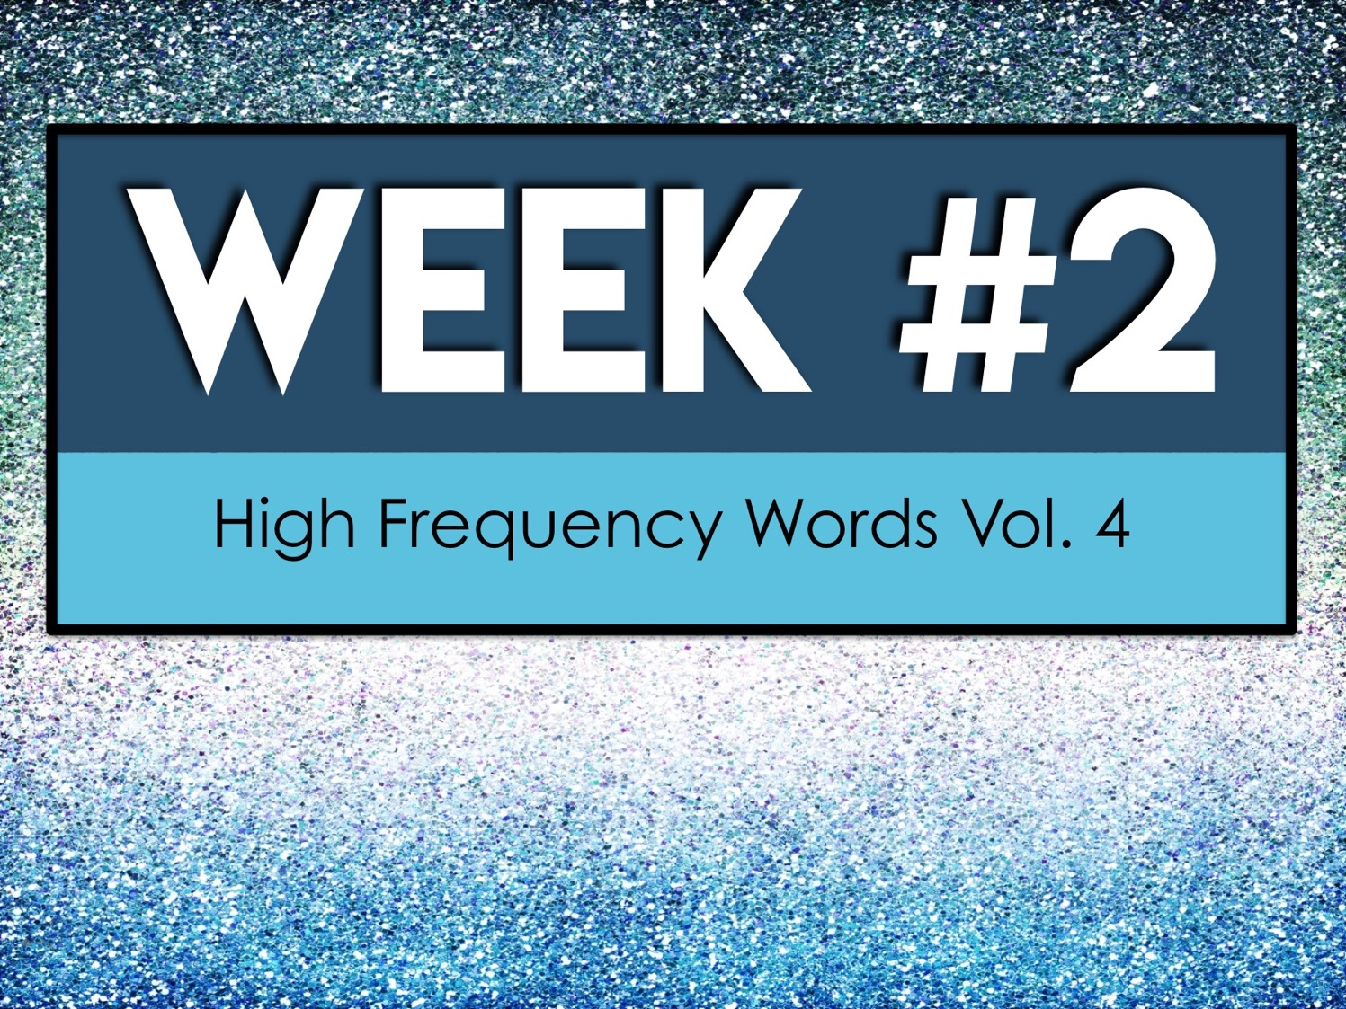
Week #2
High Frequency Words Vol. 4

Slide 23
Week #2 Words
Qualitative
Quantitative
Reinforce
Relevant
Require

Slide 24
Week #2 Pretest
DIRECTIONS: In your own words, try your best to define each term.
Qualitative
Quantitative
Reinforce
Relevant
Require

Slide 25
Qualitative
relating to, measuring, or measured by the quality of something rather than its quantity

Slide 26
Quantitative
relating to, measuring, or measured by the quantity of something rather than its quality

Slide 27
Reinforce
strengthen or support, especially with additional personnel or material

Slide 28
Relevant
closely connected or appropriate to the matter at hand

Slide 29
Require
need for a particular purpose

Slide 30

Week #3
High Frequency Words Vol. 4

Slide 31
Week #3 Words
Research
Resource
Respond
Rigid
Significant

Slide 32
Week #3 Pretest
DIRECTIONS: In your own words, try your best to define each term.
Research
Resource
Respond
Rigid
Significant

Slide 33
Research
the systematic investigation into and study of materials and sources in order to establish facts and reach new conclusions

Slide 34
Resource
a source of supply or support

Slide 35
Respond
to reply or answer in words

Slide 36
Rigid
firmly fixed or set

Slide 37
Significant
important

Slide 38
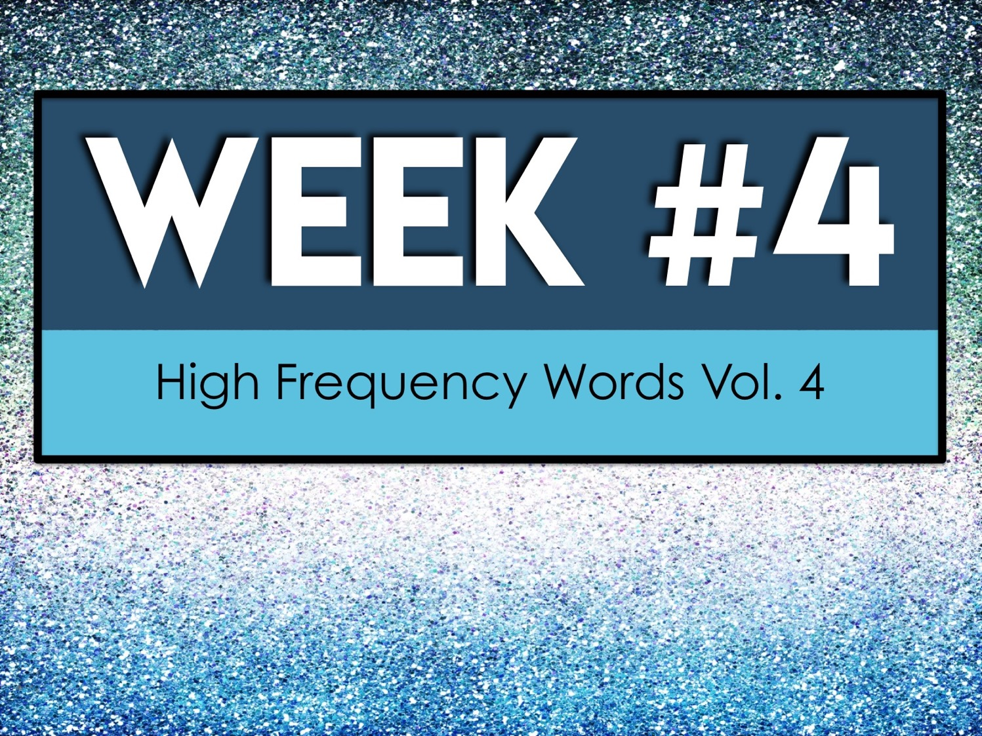
Week #4
High Frequency Words Vol. 4

Slide 39
Week #4 Words
Similar
Source
Specific
Structure
Survey

Slide 40
Week #4 Pretest
DIRECTIONS: In your own words, try your best to define each term.
Similar
Source
Specific
Structure
Survey

Slide 41
Similar
having a likeness or resemblance, especially in a general way

Slide 42
Source
the place from which something comes, arises, or is obtained

Slide 43
Specific
specified, precise, or particular

Slide 44
Structure
to construct or build a framework for

Slide 45
Survey
to take a general or comprehensive view

Slide 46
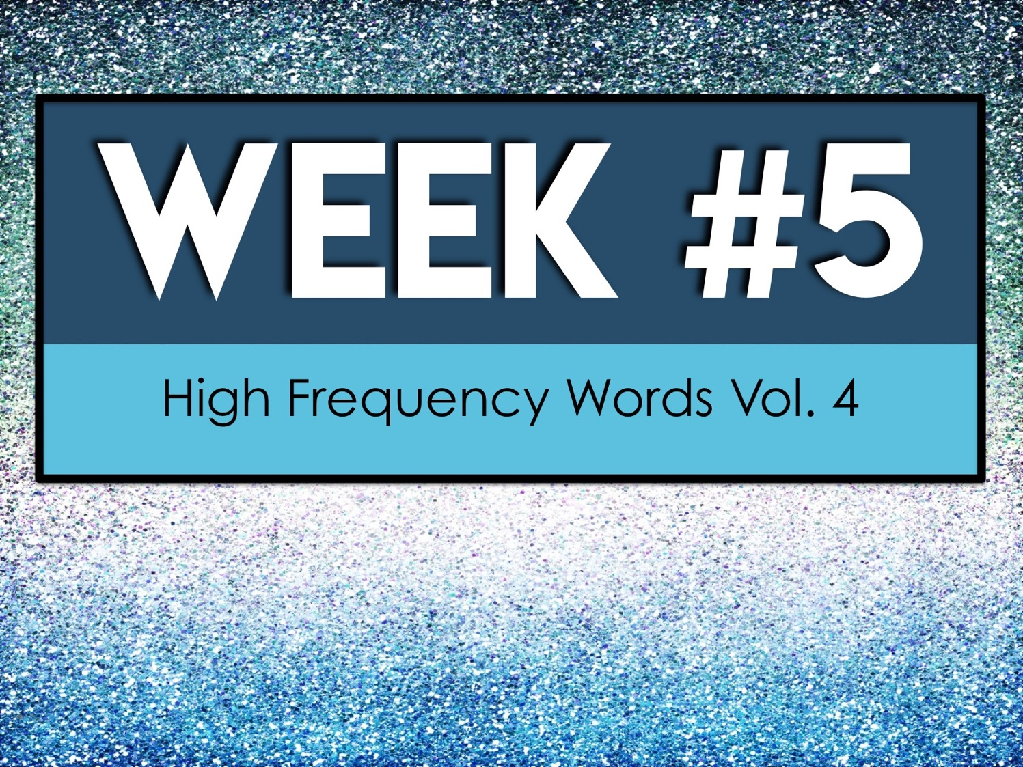
Week #5
High Frequency Words Vol. 4

Slide 47
Week #5 Words
Text
Theory
Unify
Utilize
Vary

Slide 48
Week #5 Pretest
DIRECTIONS: In your own words, try your best to define each term.
Text
Theory
Unify
Utilize
Vary

Slide 49
Text
the main body of
matter in a manuscript, book, newspaper, etc.

Slide 50
Theory
a supposition or a system of ideas intended to explain something, especially one based on general principles independent of the thing to be explained

Slide 51
Unify
make or become united, uniform, or whole

Slide 52
Utilize
make practical and effective use of

Slide 53
Vary
differ in size, amount, degree, or nature from something else of the same general class

